Slide 1
Session will begin shortly…….

Slide 2
Analogy of Quantum Computing and Q#
Jay Rank, Microsoft Student Partner – Alpha 2

Slide 3
Contents to be covered :
What is Quantum Computing ?
What is Quantum Tunnelling ?
What is Quantum Entanglement ?
What is Qubit and how to measure it ?
What is Dirac’s notation / Pauli’s measurement ?
What is Superdense Coding / a quantum logic gate ?
What is Microsoft’s QDK and how it works ?
What is Q# ?
Applications of Quantum Computing
Further sessions……

Slide 4
What is Quantum Computing ?
In order to understand what is Quantum Computing, we first need to understand why we need Quantum Computing ?
Factorization of large numbers (Shor’s Algorithm)
Searching through unstructured data (Grover’s Algorithm)
Breaking Hash Functions in Cryptography in rational time
Simulation of Quantum Systems (Photosynthesis, Complex molecules, Superconductors and much more…)
Statistical Optimization for Machine Learning models to compute and execute faster than classical models

Slide 5
What is Quantum Computing ?
Quantum Computing harnesses the unique behaviour of Quantum Physics to provide a new and powerful model of computing.
Law of Quantum Physics states that:
Matter, at a quantum level can be in a superposition of multiple classical states And those many states interfere with each other like waves in a tide pool. The state of matter after a measurement "collapses" into one of the classical states.
Quantum Entanglement occurs when particles interact in ways such that the quantum state of each cannot be described independently of the others, even if the particles are physically far apart.

Slide 6

What is Quantum Tunnelling ?
Quantum Tunnelling is the quantum mechanical phenomenon where a subatomic particle’s existence disappears from one side of a potential barrier and appears on the other side without any transmitting medium through the well. $i.e.$

Slide 7
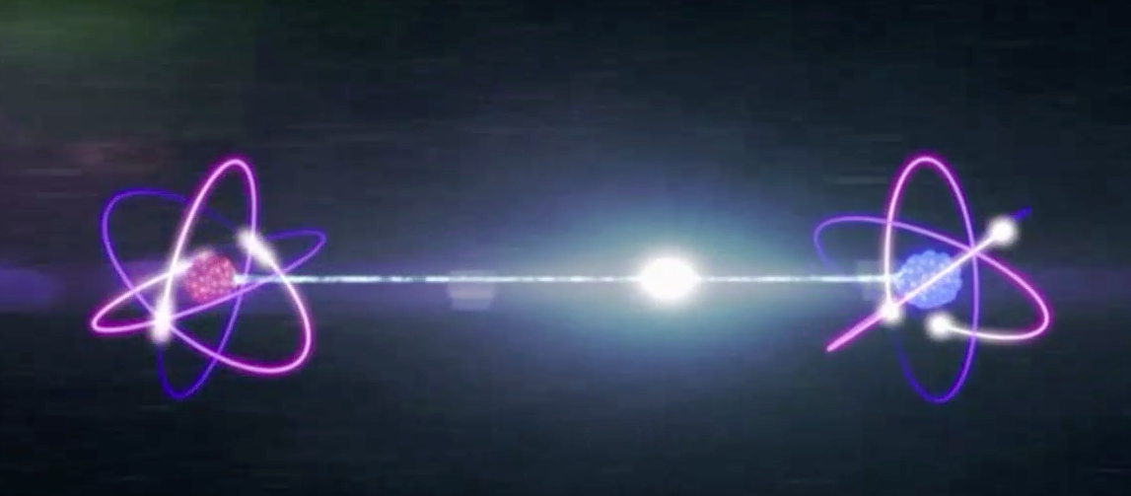

What is Quantum Entanglement ?
Quantum Entanglement occurs when particles interact in ways such that the Quantum state of each cannot be described independently of the others, even if the particles are physically far apart (even if they are separated by $infinity$).

Slide 8
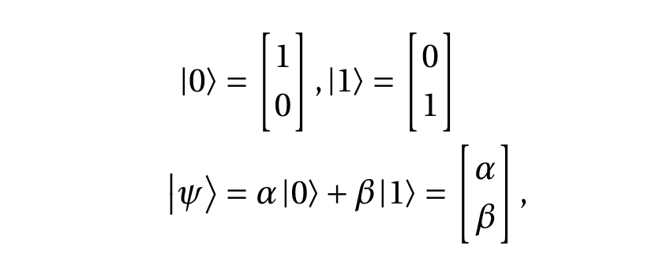
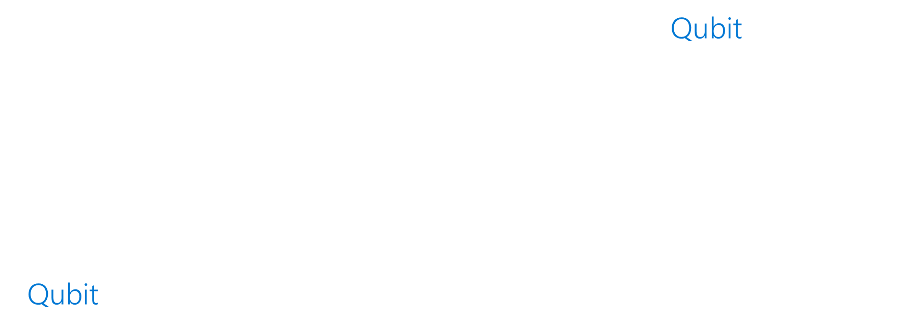
What is Qubit ?
Quantum Computing begins with the notion of a Qubit. In Quantum Computing, a Quantum bit - a Qubit - is a unit of quantum information, like a classical bit. Where classical bits hold a single binary value such as a 0 or 1, the state of a qubit can be in a superposition of 0 and 1 simultaneously $i.e.$
A classical bit at an instant can hold only one out of two values (0, 1) whereas a Qubit at an instant can hold both of two values (0, 1) in a ratio proportional to each other. This concept is also recognized as Superposition.
A Qubit can be written as:

Slide 9
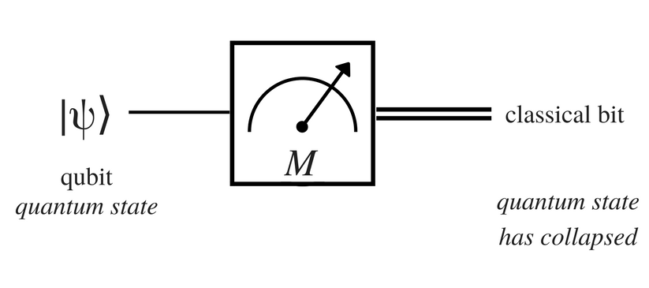

Measurement in Qubit :
A measurement corresponds to the informal idea of “looking” at a qubit, which immediately collapses the quantum state to one of the two classical states $\left[\begin{aligned}0 \\ 1\end{aligned}\right]$ or $\left[\begin{aligned}1 \\ 0\end{aligned}\right]$. When a qubit given by the quantum state vector $[α, β]$is measured, we obtain the outcome 0 with probability $|α|2$ and the outcome 1 with probability $|β|2$.

Slide 10
What is Qubit ? contd.
With measurement, the Qubit goes from being in superposition to one of the classical states. When we make a measurement of one entangled Qubit, our knowledge of the state of the other(s) is updated as well. (Quantum Entanglement)
Harnessing these quantum attributes has been the pursuit of multiple decades of quantum algorithm research, and there are many innovative techniques that have been found that solve problems in a fraction of the time it takes to solve classically.

Slide 11

What is Dirac Notation {Bra-Ket notation} ?
Of course, evaluating the tensor product is impractical because the vector lies in an exponentially large space and so this notation is in fact the best description of the state that can be given using the previous notation.
Dirac notation solves these issues by presenting a new language to fit the precise needs of quantum mechanics.
As an example of Dirac notation, consider the Bra-Ket $⟨0|1⟩$, which is the inner product between $0$ and $1$. It can be written as,
$⟨0|1⟩=\left[1 0\right] \left[\begin{aligned}0 \\ 1\end{aligned}\right]=0$

Slide 12

What is Dirac Notation {Bra-Ket notation} ?
If $ψ$ and $φ$ are quantum state vectors their inner product is $⟨φ|ψ⟩$which implies that the probability of measuring the state $|ψ⟩$ to be $|φ⟩$ is $|⟨φ|ψ⟩|2$.
The following convention is used to describe the quantum states that encode the values of zero and one (the single-qubit computational basis states):
$\left[\begin{aligned}1 \\ 0\end{aligned}\right]=|0⟩$, $\left[\begin{aligned}0 \\ 1\end{aligned}\right]=|1⟩$

Slide 13
What is Pauli’s Measurement ?
Measurement (sometimes called observation) is irreversible and therefore not a quantum gate, because it assigns the observed variable to a single value.
Measurement takes a quantum state and projects it to one of the base vectors, with a likelihood equal to the square of the vector's depth (distance) along that base vector.
This is a stochastic non-reversible operation as it sets the quantum state equal to the base vector that represents the measured state (the state "collapses" to a definite single value). Why and how, or even if this is so, is called the measurement problem.

Slide 14
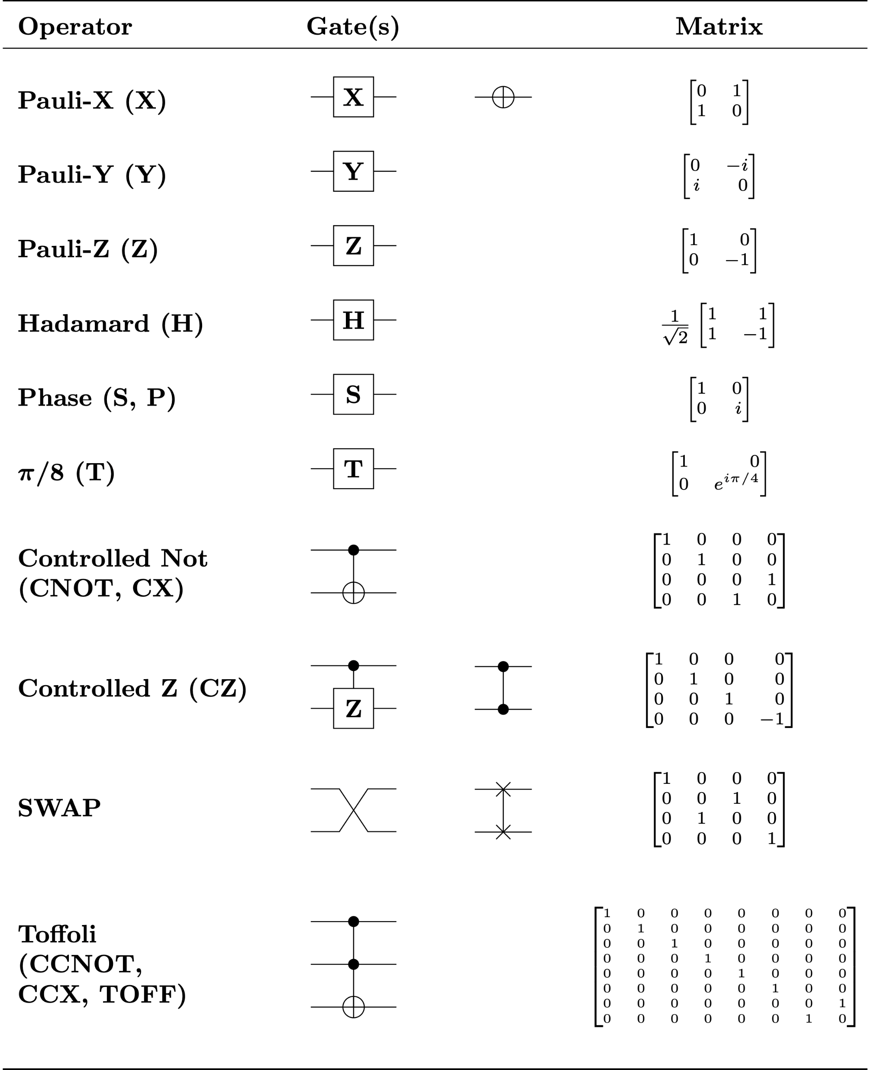
What is Quantum logic gate ?
In Quantum Computing and specifically the Quantum Circuit model of computation, a quantum logic gate (or simply quantum gate) is a basic Quantum Circuit operating on a small number of Qubits. They are the building blocks of quantum circuits, like classical logic gates are for conventional digital circuits.

Slide 15
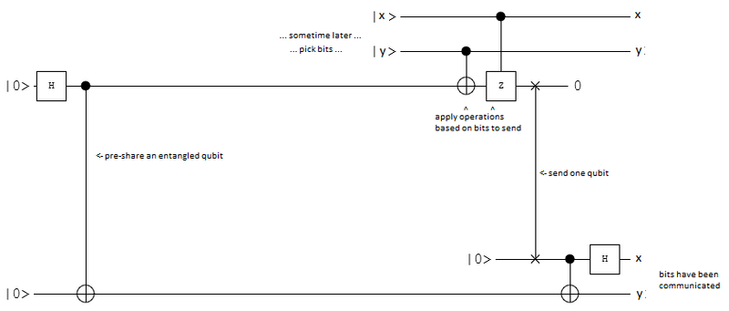
What is Superdense Coding ?
In Quantum Information theory, Superdense Coding (or dense coding) is a Quantum Communication protocol to transmit two classical bits of information (i.e., either 00, 01, 10 or 11) from a sender (Entity 1) to a receiver (Entity 2), by sending only one Qubit, under the assumption that both entities have been already pre-sharing an entangled state.

Slide 16
What is Superdense Coding ? Contd.
Suppose Entity 1 wants to send two classical bits of information (00, 01, 10, or 11) to Entity 2 using Qubits (instead of classical bits). To do this, an entangled state (e.g. a Bell state) is prepared using a Bell circuit or gate by Jay, a third person. Jay then sends one of these qubits (in the Bell state) to Entity 1 and the other to Entity 2. Once Entity 1 obtains a qubit in the entangled state, it applies a certain quantum gate to its own qubit depending on which two-bit message (00, 01, 10 or 11) it wants to send to Entity 2. This entangled qubit is then sent to Entity 2 who, after applying the appropriate quantum gate and making a measurement, can retrieve the classical two-bit message. Observe that Entity 1 does not need to communicate to Entity 2 which gate to apply in order to obtain the correct classical bits from its projective measurement.

Slide 17
What is Microsoft’s Quantum Development Kit (QDK) ?
Microsoft's quantum program is unique in that they focus on scaling each and every component of the system to deliver real quantum impact. This comprehensive approach of building the hardware involves:
Building a quantum computer using reliable, scalable, and fault-tolerant topological qubits.
Engineering a unique cryogenic control plane with low power and heat dissipation.
Developing a complete software stack to enable programming the quantum computer and controlling the system at scale.
The open-source Quantum Development Kit (QDK) has been introduced to make quantum programming and algorithm development more accessible.

Slide 18
Working of Quantum Development Kit :
Applications developed with Microsoft's Quantum Development Kit consist of two parts:
One or more Quantum Algorithms, implemented using the Q# quantum programming language.
A host program, implemented in a programming language like Python or C# that serves as the main entry point and invokes Q# operations to execute a Quantum Algorithm.

Slide 19
What is Q# ?
Microsoft’s high-level programming language, Q#, addresses the challenges of quantum programming.
We designed Q# as a high-level quantum-focused programming language focused on algorithm and application development.
The Q# compiler is integrated into a software stack that enables a quantum algorithm to be compiled down to the primitive operations of a quantum computer.
Up to a certain scale (number of qubits), Quantum Computing can be simulated on a classical computer.

Slide 20
Introduction to Q# :
Follow this steps to setup your quantum application :
Choose a location (any appropriate directory) for your application.
Create a file called Bell.qs . This file will contain your Q# code.
Create a file called Host.py . This file will contain your Python host code.

Slide 21
Introduction to Q# :
The Python host application has three parts :
Compute any arguments required for the quantum algorithm. In the illustration to be covered, count is fixed at a 1000 and initial is the initial value of the qubit.
Run the quantum algorithm by calling the simulate() method of the imported Q# .
Process the result of the operation. In the example, res receives the result of the operation. Here the result is the tuple of the number of zeroes (num_zeroes) and the number of ones (num_ones) measured by the simulator. We deconstruct the tuple to get the two fields, and print the results.

Slide 22
Decode the <Encoding>

Slide 23
Applications of Quantum Computing ?
Quantum Simulation : Photosynthesis, superconductors, and complex molecules are examples of quantum systems that can be simulated using quantum programs.
Cryptography : Classical cryptography relies on the intractability of operations on large numbers, such as the factorization of large numbers into two prime numbers. Quantum computing makes these operations theoretically tractable (via Shor's algorithm).

Slide 24
Applications of Quantum Computing ? Contd.
Optimization : On a quantum computer, we can speed up optimization algorithms, enabling finding solutions that otherwise were not possible. Applications range from transportation and logistics, healthcare, diagnostics, and material science.

Slide 25
Applications of Quantum Computing ? Contd.
Machine Learning : A great number of numerical calculations on classical computing consist mainly of solving linear systems of equations, especially true in the field of machine learning where most of the computation cost goes into calculating the inverse of huge matrices. Fortunately, there is a quantum algorithm that allows us to approximately solve the system exponentially faster than a classical computer. The algorithm opens the door to great speedups in every problem that needs the solution to linear systems of equations. Solutions to problems in these areas will help address the energy crisis, climate change, food scarcity, and personal and precise medical diagnosis.

